Slide 1
Chapter3 Filtering & Enhancing Images
图像增强基本概念
图像增强的基本方法：点方法，模板法，直方图变换
点方法特点及典型方法
模板法特点及典型方法：平滑和锐化
直方图的概念及特点，直方图均衡化原理，缺点及其改进
图像增强的应用

Slide 2
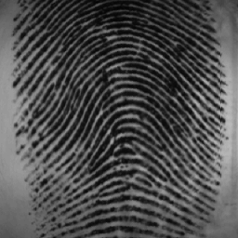
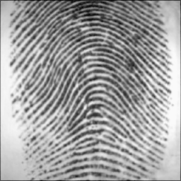
Chapter 3: Filtering & Enhancing Images
This chapter is about image processing, since the methods take an input image and create another image as output. Other appropriate terms often used are filtering, enhancement, or conditioning.
The major motion is that the image contains some signal or structure, which we want to extract, along with uninteresting or unwanted variation, which we want to suppress.

Slide 3
Contents
(1) What Needs Enhancement?
(2) Image Enhancement in the Spatial(空间的) Domain
Point Operation
Linear Point Operation
Nonlinear Point Operation
Spatial (mask) Operation
Noise Smoothing
Median Filtering
Sharping Masking
Zooming
Histogram Transforms
(3) Image Enhancement in the Frequency Domain Operation

Slide 4
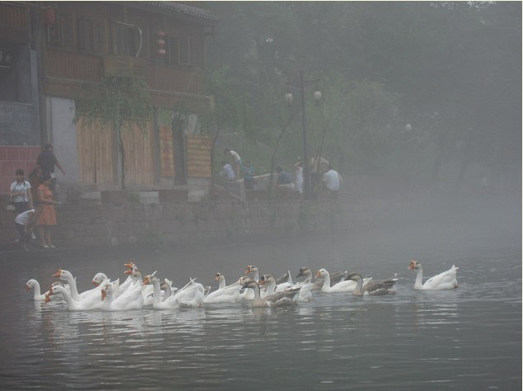
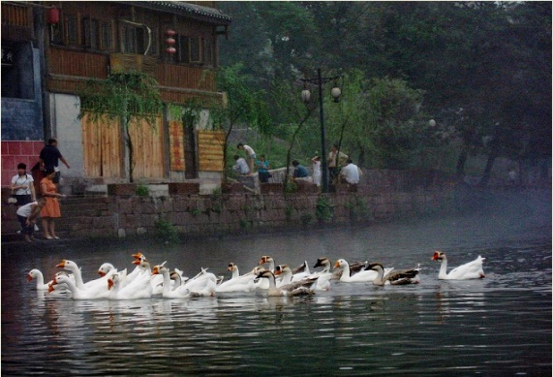
What Needs Enhancement?
Before launching into the methods of this chapter, it is useful to review some of the problems that need them. Two general categories of problems follow.
An image needs improvement (poor contrast, noise,…)
Sharpening of image features ( such as edges or boundaries) to make a graphic display more useful for analysis.
Low‑level features must be detected

Slide 5
Image enhancement operators improve the detectability of important image details or objects by man or machine.
Example operations include noise reduction (smoothing), contrast stretching（拉伸）, and sharpening (edge enhancement).
Image enhancement is subjective（主观的） (problem/application oriented)

Slide 6
Image Enhancement - Method
Spatial Domain (image plane)
(1) Points Process: Gray level transformation
(2) Mask (Area) Process: Spatial filters
(3) Frame（框架） Process: Histogram Transforms
Frequency Domain
Combination Methods

Slide 7
SPATIAL DOMAIN METHODS
Transforming the pixels via a single function that maps an input gray value into a new output value
Spatial domain processes will be denoted by the expression
g(x,y)=T(f(x,y))
Where f(x,y) in the input image,g(x,y) is the processed image and T is as operator on f, defined over some neighborhood of(x,y)

Slide 8
Histogram Transforms
1 | 2 | 3 | 4 | 5 | 6
5 | 4 | 5 | 6 | 2 | 14
5/36 | 4/36 | 5/36 | 6/36 | 2/36 | 14/36
example
1 | 2 | 3 | 4 | 5 | 6
6 | 4 | 3 | 2 | 2 | 1
1 | 6 | 6 | 4 | 6 | 6
3 | 4 | 5 | 6 | 6 | 6
1 | 4 | 6 | 6 | 2 | 3
1 | 3 | 6 | 4 | 6 | 6

Slide 9
Question:
直方图与图像的对应关系？
一对一？ 一对多？ 多对一？ 多对对？

Slide 10
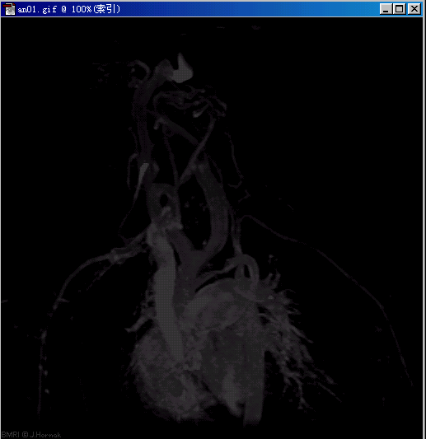
Histogram Characteristic
The histograms of four basic types of images :
H(z)
The gray levels are concentrated toward the dark end of the grayscale range. Thus this histogram corresponds to an image with overall dark characteristics.
Dark image
Gray level z
Dark image

Slide 11
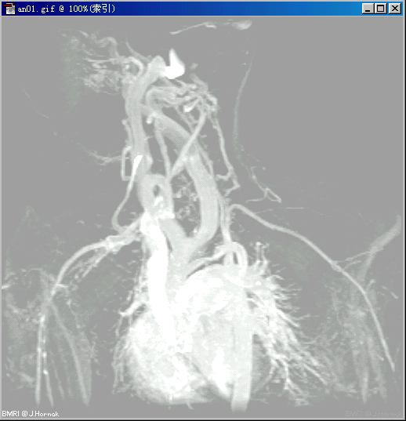
Histogram Characteristic
H(z)
Just is the opposite of the above.
Bright image
Gray level z
Bright image

Slide 12
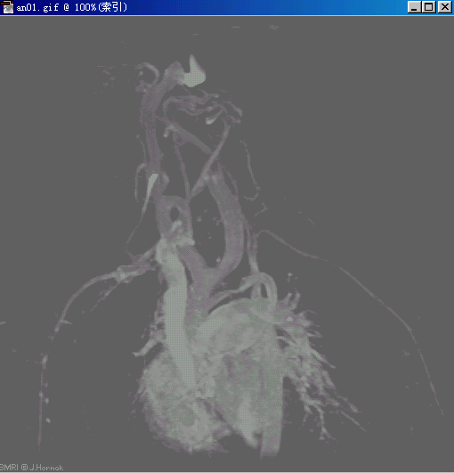
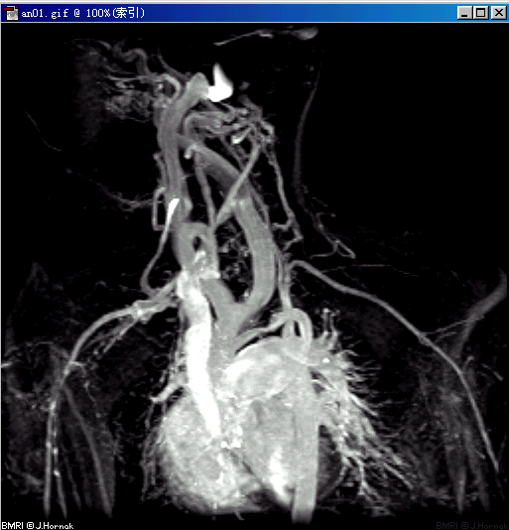
The histogram has a narrow shape, which indicates little dynamic range and thus corresponds to an image having low contrast.
H(z)
Low-contrast image
Gray level z
The histogram has significant spread, corresponding to an image with high contrast.
H(z)
Low-contrast image
High-contrast image
Gray level z
High-contrast image

Slide 13
Histogram Modification
When is it necessary to modify the Histogram of an image
The histogram of the “bad” image is very narrow (Fig. a), while the histogram of the “good” image is more spread (Fig. b).
To change a “bad” image to the “good” image, we need modify the histogram.
Number of pixels
Number of pixels
Fig.a - bad image
Fig.b - good image
Gray level r
Gray level s

Slide 14
Histogram Equalization
Histogram equalization（直方图均衡化） is an important method in histogram modification.
1
0
1
0
1
Histogram equalization is often tried to enhance an image.
Notes:
变化后灰度级具有均匀概率密度分布

Slide 15
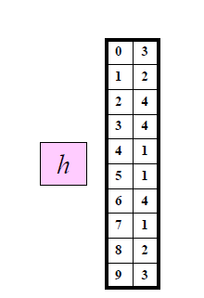
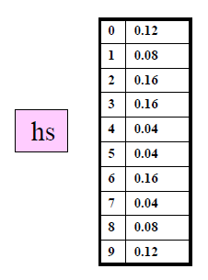
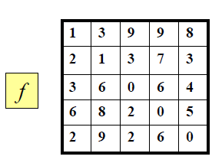
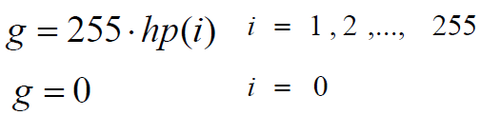
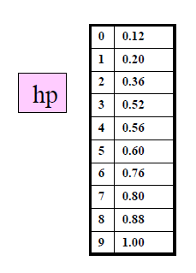
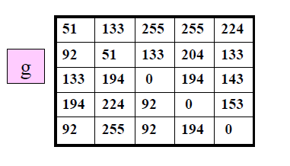
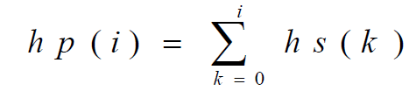
Example-method1

Slide 16
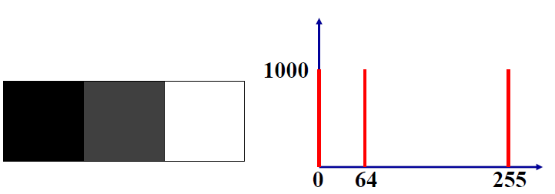
Example-method1
f(x,y):300*100
s(0)=1000/3000
s(64)=1000/3000
s(255)=1000/3000
16

Slide 17
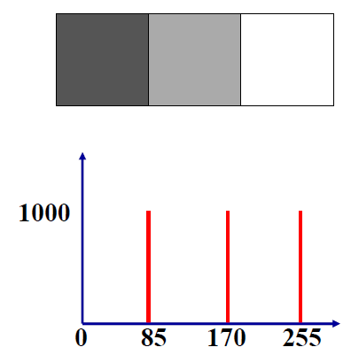
s(0)=1/3
s(64)=s(0)+s(64)=2/3
s(255)=1
T(0)=1/3*255=85
T(64)=2/3*255=170
T(255)=1*255=255
Results of histogram equalization and his histogram
17

Slide 18
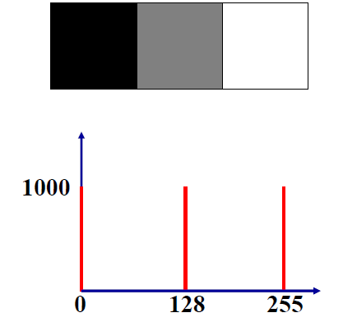
Method 2:

Slide 19
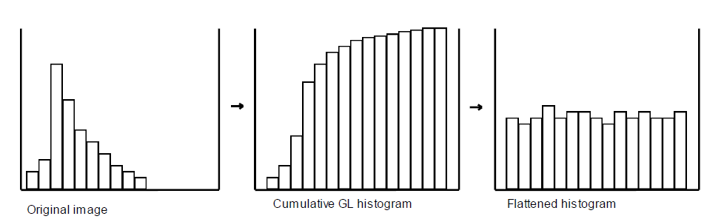
Note:
(1) re-quantization method is arbitrary
(2) may not get a 1-1 mapping ⇒ inverse problem
(3) may not get a flat(平的) histogram unless L is large
Adv
这种方法对于背景和前景都太亮或者太暗的图像非常有用，这种方法尤其是可以带来X光图像中更好的骨骼结构显示以及曝光过度或者曝光不足照片中更好的细节。这种方法的一个主要优势是它是一个相当直观的技术并且是可逆操作，如果已知均衡化函数，那么就可以恢复原始的直方图，并且计算量也不大
Notes:
变换后灰度级减少，即“简并”现象

Slide 20
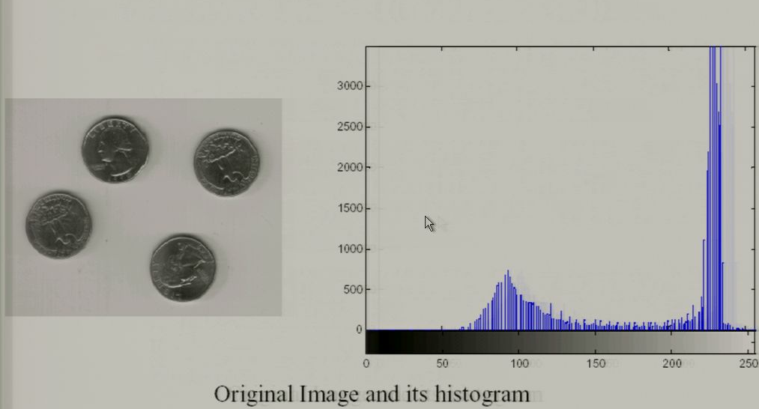
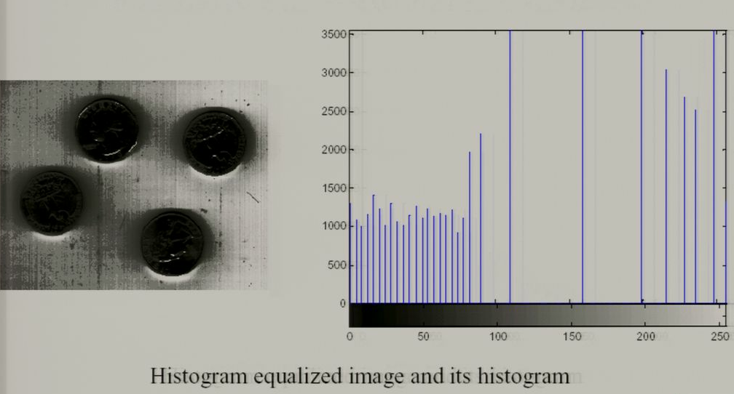
The Drawback of Histogram Equalization
可能会增加背景杂讯的对比度并且降低有用信号的对比度；变换后图像的灰度级减少，某些细节消失；某些图像，如直方图有高峰，经处理后对比度不自然的过分增强。

Slide 21
Histogram Matching(Specification)
It is not useful sometimes to enhancing image used histogram equalization.
The method used to generate a processed image that has a specified histogram is called histogram matching.
Continuous gray levels r and z.

Slide 22
Points Process
Definition - A point operator applied to an image is an operator in which the output pixel is determined only by the input pixel, namely,point by point operation.
Out[x, y] = f (In[x, y]);
100 | 8 | 6
16 | 20 | 10
50
4
3
Operator:(Div.by 2)

Slide 23
Points Operation
Methods
Linear transformation
Nonlinear transformation
Out[x, y] = f (In[x, y]);

Slide 24
Points Operation
Linear transformation
g(x,y)
g(x,y)
d
d
a=0 and c=0
c
0
a
b
f(x,y)
0
b
f(x,y)

Slide 25
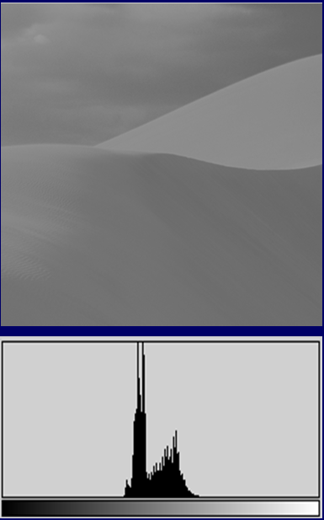
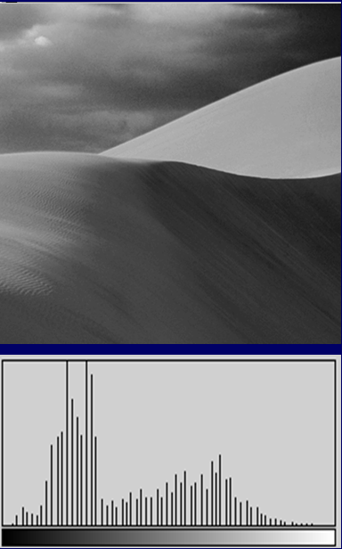
主要用于爆光不足或过度时，改善图片质量层次不明，模糊问题
Notes:
主要用于爆光不足或过度时，改善图片质量层次不明，模糊问题

Slide 26
Contrast stretching
Remapping the gray values is often called stretching, and which is a simple image enhancement technique that improves the contrast.
A contrast s tretching operator is a point operator that uses a piecewise smooth function f (In[x, y]) to enhance important details of the image.
255
255
142
48
218
255
255
Contrast stretch
Contrast compression

Slide 27
Piecesise-Linear transformation
g(x,y)
M_{g}
d
c
0
a
b
M_{f}
f(x,y)

Slide 28
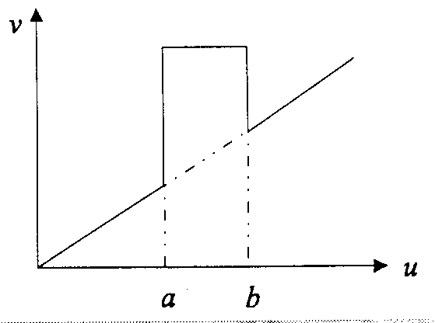
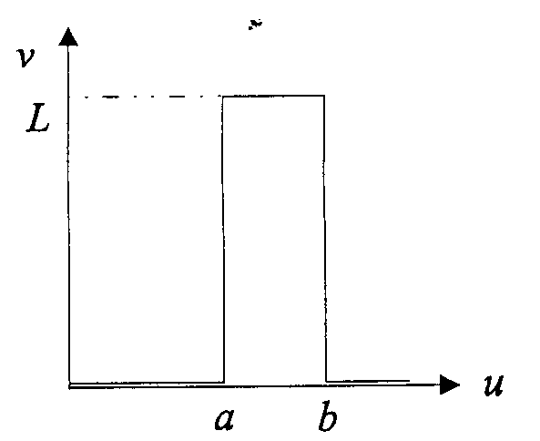
Intensity Level Slicing 灰度级切片
With background:
Without background:
28

Slide 29
Intensity Level Slicing
29
Fully illuminates pixels lying in the interval [a,b] and removes the background.
Segmentation of certain gray level region
e.g. Image from remote sensing.

Slide 30
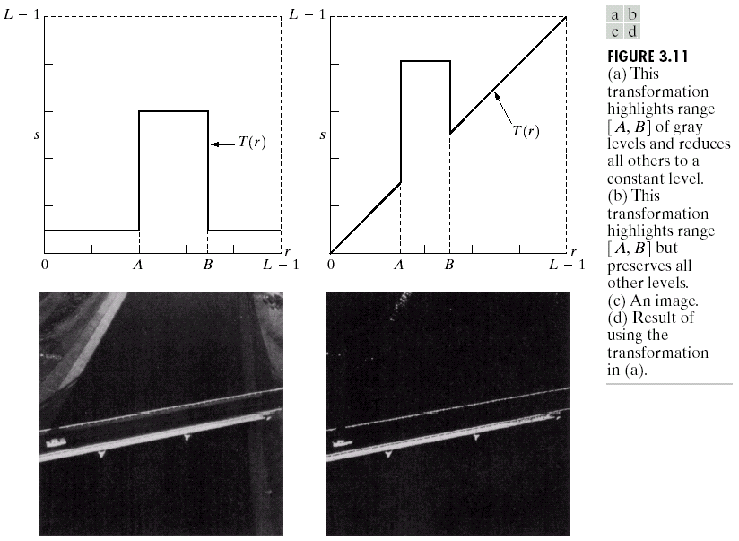
Using (a) transformation

Slide 31
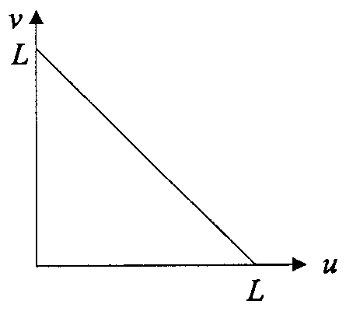
IMAGE NEGATIVES
Create digital negative of images
Display of medical images
Logic operations:
NOT, AND, OR, XOR
NOT:
31

Slide 32
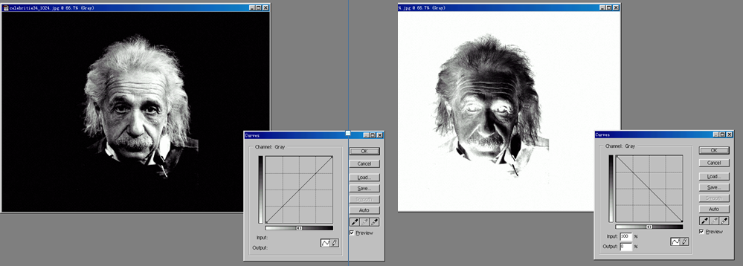
Mapping function (Reverse)
Input image
255
g_{out}
f(x)=x ⁻¹
0
g_{in}
255
Output image
32

Slide 33
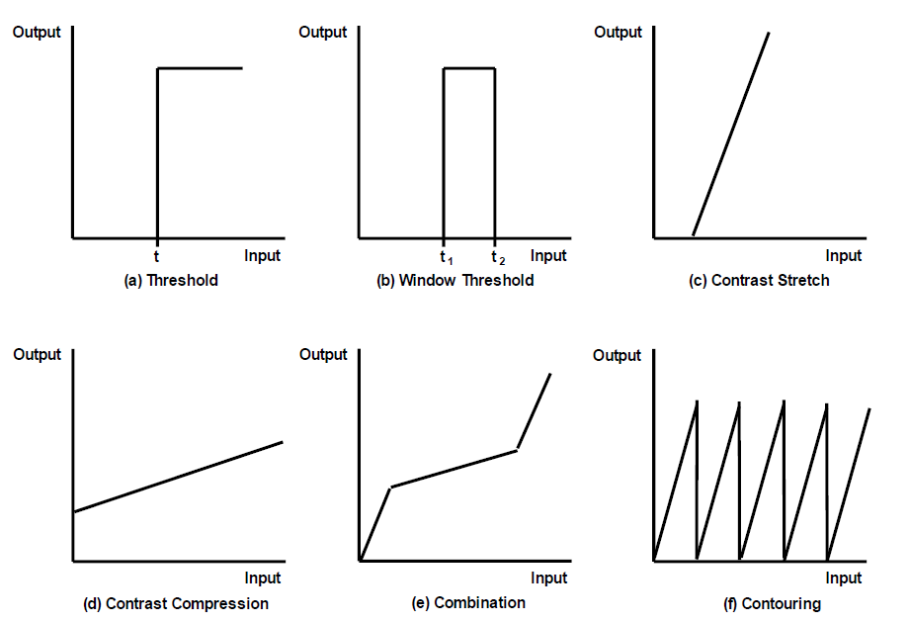
Linear transformation

Slide 34
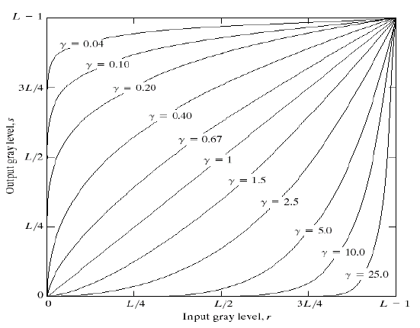
Power-Law Transformations
r<1: map a wider range of input values into a narrow range of output values, image brighter
r>1: map a narrow range of input values into a wider ranger of output values, image darkening
34

Slide 35
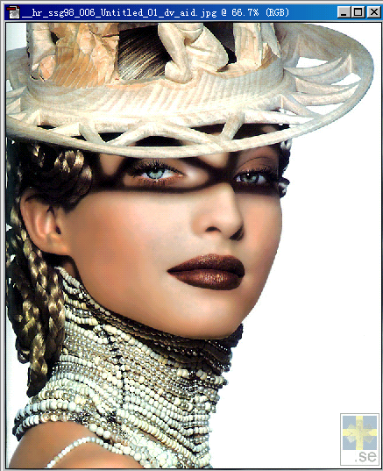
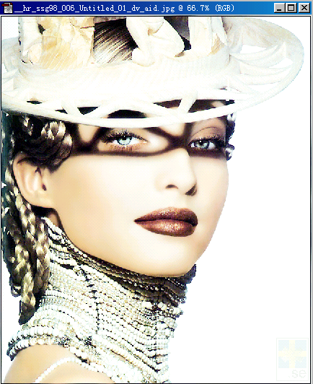
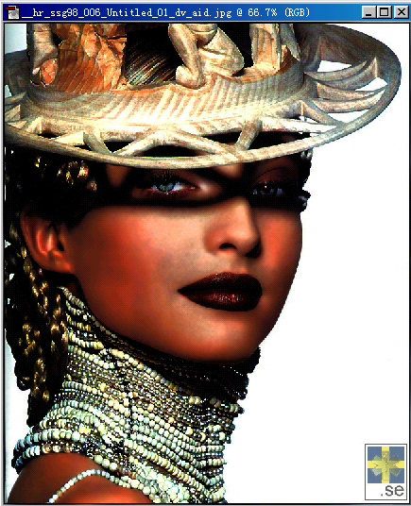
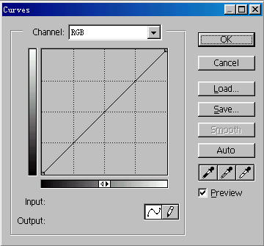
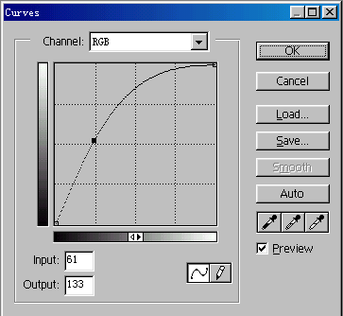


Slide 36
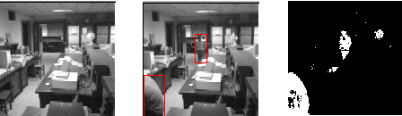
Subtraction:C(x,y)=A(x,y)-B(x,y)
Object detection: the difference between two images
36

Slide 37
Multiplication: C(x,y)=A(x,y)×B(x,y)
The least used method.
Generate the extreme range of values.

Slide 38
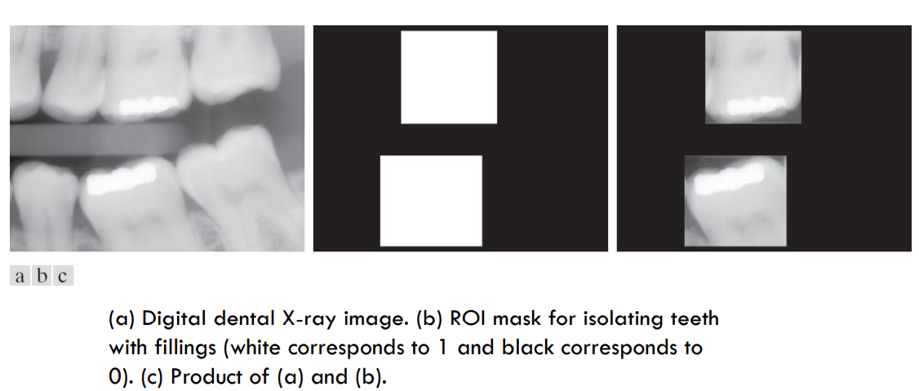

Slide 39
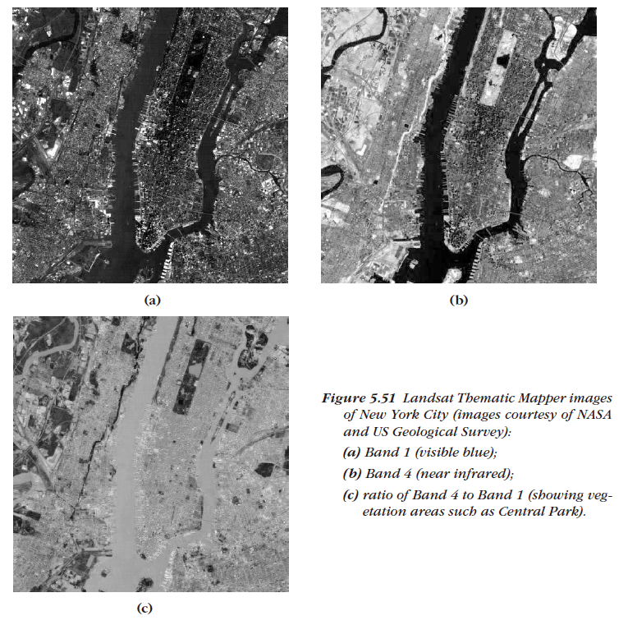
division: C(x,y)=A(x,y)/B(x,y)
可以用来纠正由于照明或传感器的非均匀性造成的图像灰度阴影，还被用于产生比率图像。
Notes:
避免除以0

Slide 40
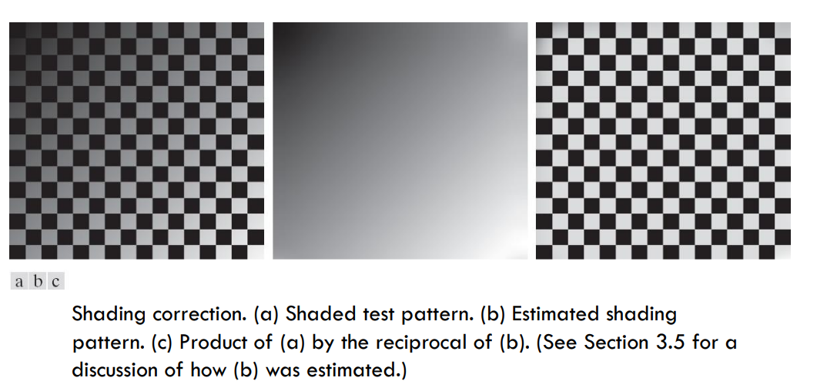

Slide 41

AND:
41

Slide 42
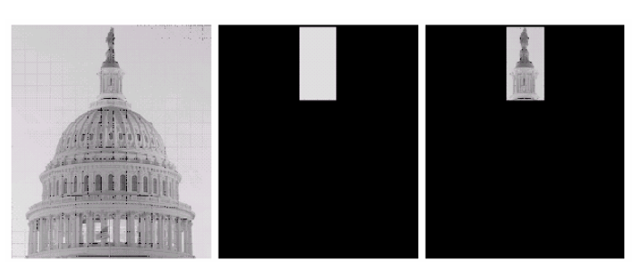

Slide 43

OR:
43

Slide 44
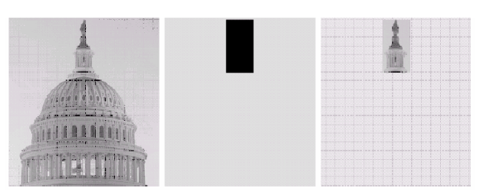

Slide 45
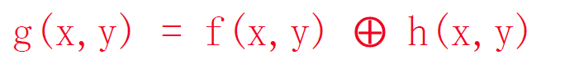

XOR:

Slide 46
Example
g(0,0)=100*3+101*2+96*2+106*1
g(0,1)=100*2+101*3+98*2+
96*1+106*2+103*1

Slide 47
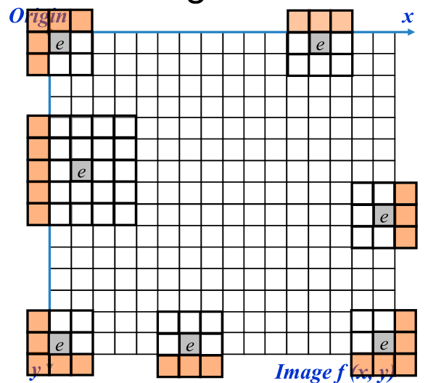
At the edges of an image we are missing pixels to form a neighborhood.
Solutions?

Slide 48
Discard the problem pixels (e.g. 512x512 input 510x510 output if mask size is 3x3)
Padding the image
adding rows and columns of 0
replicating rows or columns

Slide 49
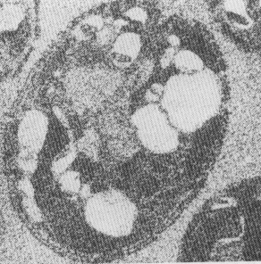
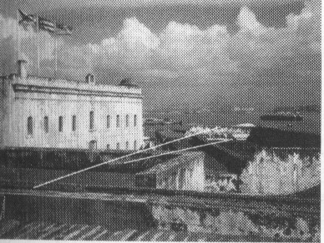
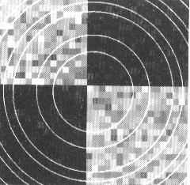
Image Smoothing
Often, an image is composed of some underlying ideal structure, which we want to detect and describe, together with some random noise or artifact, which we would like to remove.
Scratches
Image contains artifacts
Image with random noise
Image contains both Gaussian noise and bright ring artifacts

Slide 50
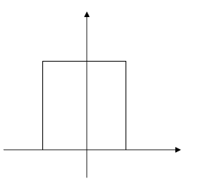
Box Filter (Averaging filter)
Definition : Smoothing an image by equally weighting a rectangular neighborhood of pixels is called using a box filter.
Output-Image [r,c] = Average of some neighborhood of
Input-Image [r,c]
Example: 5×5 Neighborhood Filter - averages 25 pixel values in a 5×5 neighborhood of the input image pixel in order to create a smoothed output image.

Slide 51
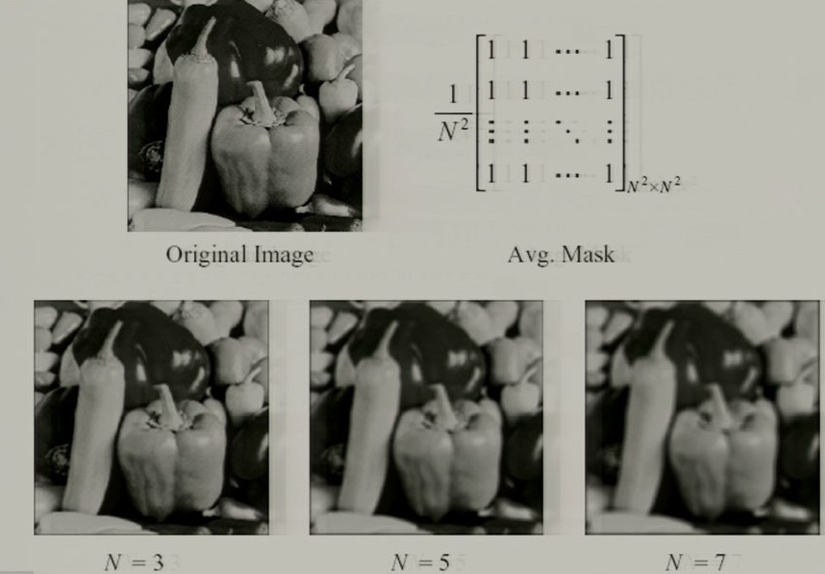

Slide 52
Gaussian Filter
Rather than weight all input pixels equally, it is better to reduce the weight of the input pixels with increasing distance from the center pixel I[x_{c}, y_{c}]. The Gaussian filter does this and is perhaps the most commonly used of all filters.
Definition : When a Gaussian filter is used, pixel [x,y] is weighted according to
g(x)
d is the distance of the neighborhood pixel [x, y] from the center pixel [x_{c}, y_{c}] of the output image where the filter is being applied.
d
x
[x]
[x]
[x_{c}]
Notes:
σ为函数的宽度参数 , 控制了函数的径向作用范围

Slide 53
A 7×7 mask approximating a Gaussian with σ = 2 obtained by using
距离,中心为（0，0）
3D Representation
to generate function values for integers x and y and then setting c = 90 so that the smallest mask element is 1.
1
3
7
9
7
3
1
3
12
26
33
26
12
3
7
26
55
70
55
26
7
G_{7×7}=
9
33
70
90
70
33
9
7
26
55
70
55
26
7
3
12
26
33
26
12
3
1
3
7
9
7
3
1
Int(Exp(-(1+0)/8)*90)=70
Int(Exp(-(2+2)/8)*90)=55
2D Representation

Slide 54
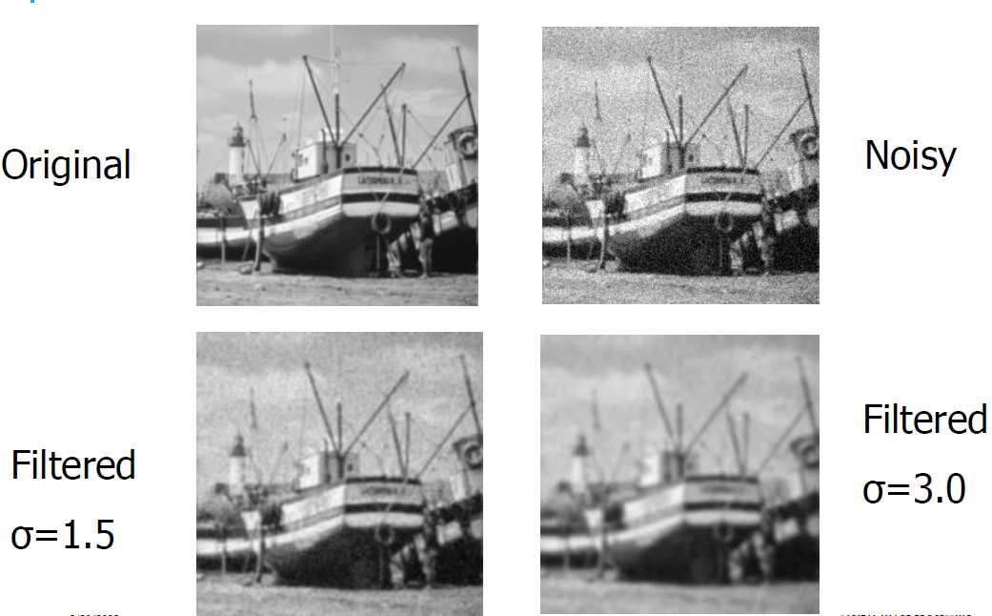
Example

Slide 55
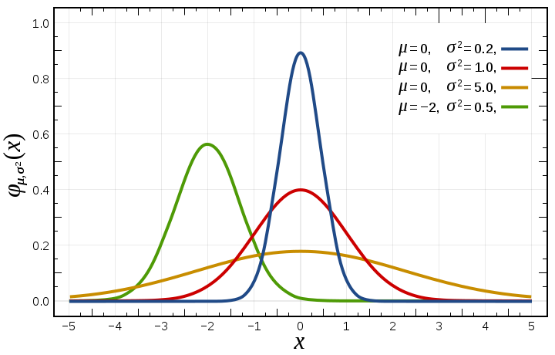

How to set sigma?
Depend on application
Common strategy: proportional(相称的) to image size

Slide 56
Properties of Gaussian blur
Weights independent of spatial location
Does smooth images
But smoothes too much, and edges are blurred.

Slide 57


Nonlinear filter-bilateral Filtering
Bilateral ﬁltering is a technique to smooth images while preserving edges
Bilateral filter: combined domain and range filtering
空域信息（domain）和值域信息（range）
d(i,j,k,l)
r(i,j,k,l)
Reference：
1. C Tomasi, R Manduchi.Bilateral Filtering for Gray and Color Images, Computer Vision, 1998.

Slide 58



Slide 59


Slide 60
How to Set the Parameters
Depends on the application.
For instance:
• space parameter: proportional to image size
– e.g., 2% of image diagonal
• range parameter: proportional to edge amplitude
– e.g., mean or median of image gradients

Slide 61

Removal of Salt-and-Pepper Noise (Binary Image)
The presence of single dark pixels in bright regions, or single bright pixels in dark regions, is called salt‑and‑pepper noise.
Often, salt‑and‑pepper noise is the natural result of creating a binary image via thresholding.
Salt corresponds to pixels in a dark region that somehow passed the threshold for bright.
Pepper corresponds to pixels in a bright region that were below threshold for dark.
Pepper
H(z)
Salt
Gray level z

Slide 62


Pepper noise
1
1
1
1
1
1
1
0
1
1
1
1
1
1
1
1
1
1
Pepper noise removed using 8‑neighbors
0
0
0
0
0
0
Binary image of bacteria
0
1
0
0
0
0
Salt‑and‑pepper noise removed using 8‑neighbors
0
0
0
0
0
0
Salt noise removed using 8‑neighbors
Salt noise
Removal of Salt-and-Pepper Noise by Mask

Slide 63

Pepper noise
1
1
1
0
1
1
1
1
1
1
Pepper noise removed using 4‑neighbors
0
0
Binary image of bacteria
0
1
0
0
0
0
Salt‑and‑pepper noise removed using 4‑neighbors
0
0
Salt noise removed using 4‑neighbors
Salt noise
Removal of Salt-and-Pepper Noise by Mask

Slide 64
Nonlinear filter-Median Filtering
Definition --- Let A[i] _{i = 0, 1, …(n-1)} be a sorted array of n real numbers. The median of the set of numbers in A is A[(n ‑ 1)/2]
For odd n, the array has a unique middle as defined above.
If n is even, then we can define that there are two medians, at A[n/2] and A[n/2 ‑ 1], or one median, which is the average of these two values, namely:
A[n/2] = Median value g₁
A[n/2 ‑ 1] = Median value g₂
Median value (g₁ + g₂)/2
In Median Filter, a pixel value is replaced with the median value of the neighborhood.

Slide 65
Example
i = 0, 1, 2, 3, 4, 5, 6, 7, 8, 9, 10, 11, 12
A[i] = 0, 3, 5, 8, 9, 12, 13, 18, 20, 30, 40, 50, 80
A[(n-1)/2] = A[(13-1)/2] = A[6] = 13
0
3
8
12
3
0
3
8
12
3
5
40
30
9
13
5
40
30
9
13
40
40
80
80
0
40
40
80
13
80
0
50
30
80
80
8
50
30
80
80
8
20
40
20
30
18
20
40
20
30
18

Slide 66
Computing the median requires more computation time than computing a neighborhood average, since the neighborhood values must be partially sorted.
Moreover, median filtering is not so easily implemented in special hardware that might be necessary for real‑time processing, such as in a video pipeline.
However, in many image analysis tasks, its value in image enhancement is worth the time spent.

Slide 67
Nonlinear filter-Rank-order Filtering
Elements under the mask are ordered, and a particular value is returned.
instance : median filter, max filter, min filter
g=ordfilt2(f, order, domain)
e.g.
min filter: g=ordfilt2(f,1,ones(m,n))
Max filter g=ordfilt2(f,m*n,ones(m,n))

Slide 68
Magnification of Image (Zoom)
(a) Replication（最近邻插值）
Zero Order Hold: each pixel along a scan line id repeated once, and each scan line is repeated.
For an image, interlace it by rows and columns of zero to get a matrix, then convolve with
68

Slide 69


Magnification of Image (Zoom)
Zooming by replication from 128×128 to 256 ×256 and 512× 512 images
69

Slide 70
(b) Linear Interpolation
First Order Hold-straight line fitted between pixels along row, then column.
Can also be obtained by interlacing the image by rows and columns of zero, and then convolve with
70

Slide 71


Zooming by linear interpolation from
128 ×128 to 256 × 256 and 512 × 512 images
71

